Slide 1
PREDICTING loan approval
LHL Week 8 presentation
Emily Stickland

Slide 2
AGENDA
Introduction and goals
Data Preparation and EDA
Logs and Scaling
ML Models and Challenges
Evaluating Models
Areas for future research

Slide 3

DATA PREPARATION
Checking duplicates
Different things to do with NaNs
Drop rows for income or loan amount
Median – loan amount term
Mode – married, gender
Make 0 for children
Credit History – what to do?
Initial thought to make it 0
But this isn’t the mode
Only 50 rows – drop them
Removing outliers for Income and Loan Amount

Slide 4
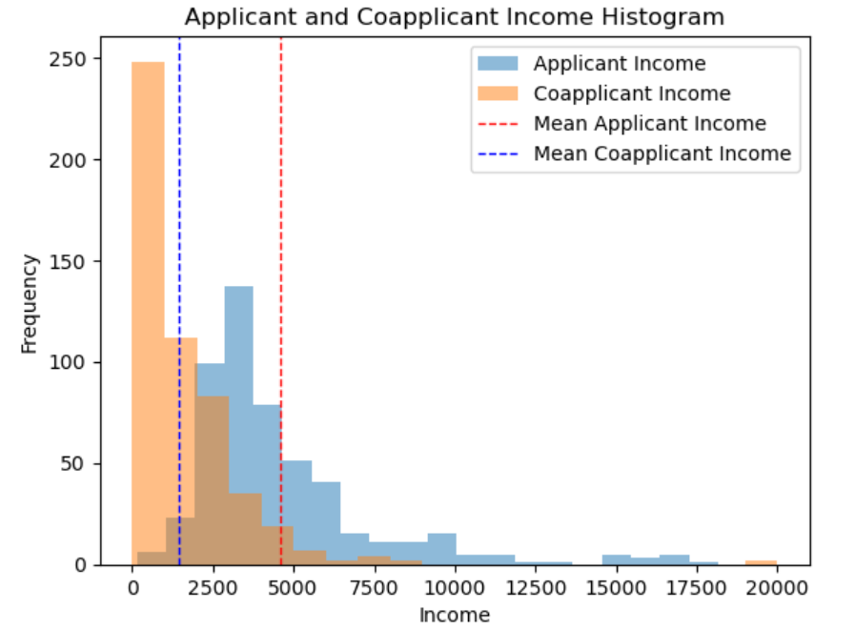
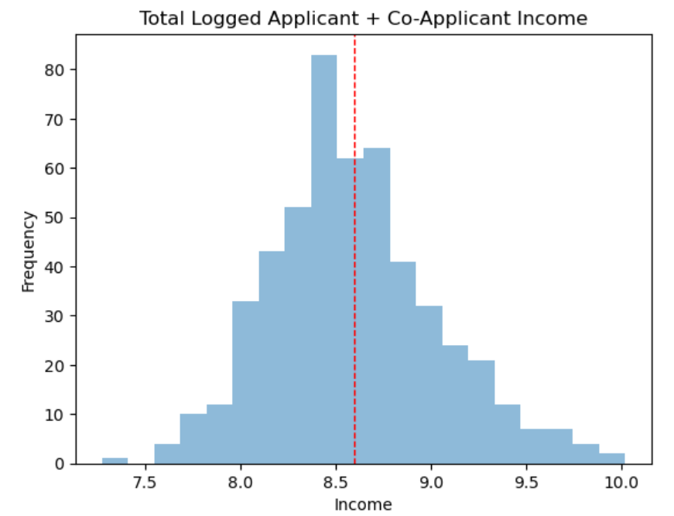
TRANSFORMING DATA: INCOME
Mean of Applicant income: $4582
Mean of Co-Applicant income: $1423
Non-normal distribution
Outliers dropped
Incomes Combined
Log transformed

Slide 5
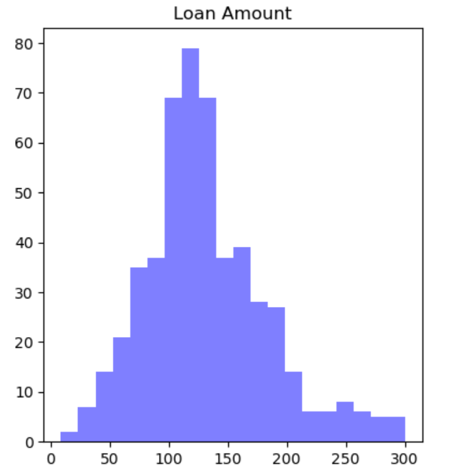
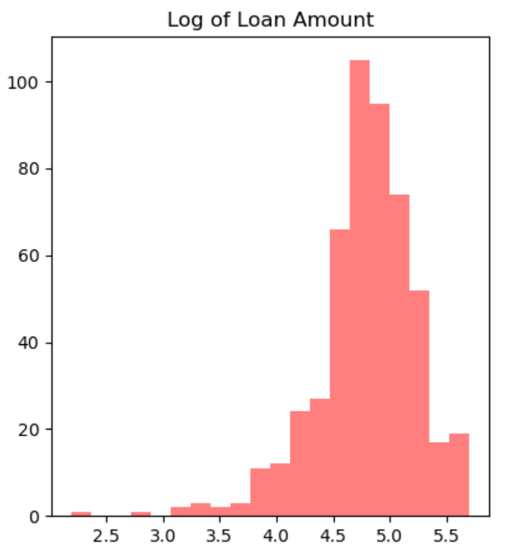
TRANSFORMING DATA: LOAN AMOUNT
Because outliers were dropped, doing a log transform of loan amount only made the skew worse

Slide 6
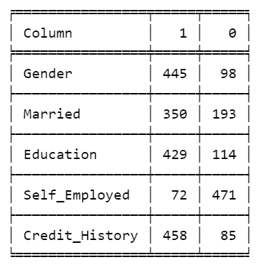
TRANSFORMING DATA: CATEGORICAL VARIABLES
Label encoding for binary values:
Gender
Marital status
Education
Self-Employment
Credit history
… and loan amount!
Usually 0 is assigned to the mode of the binaries (unless already 1/0, yes/no
I reversed this for education
One-hot encoding for :
Property type
Number of children

Slide 7
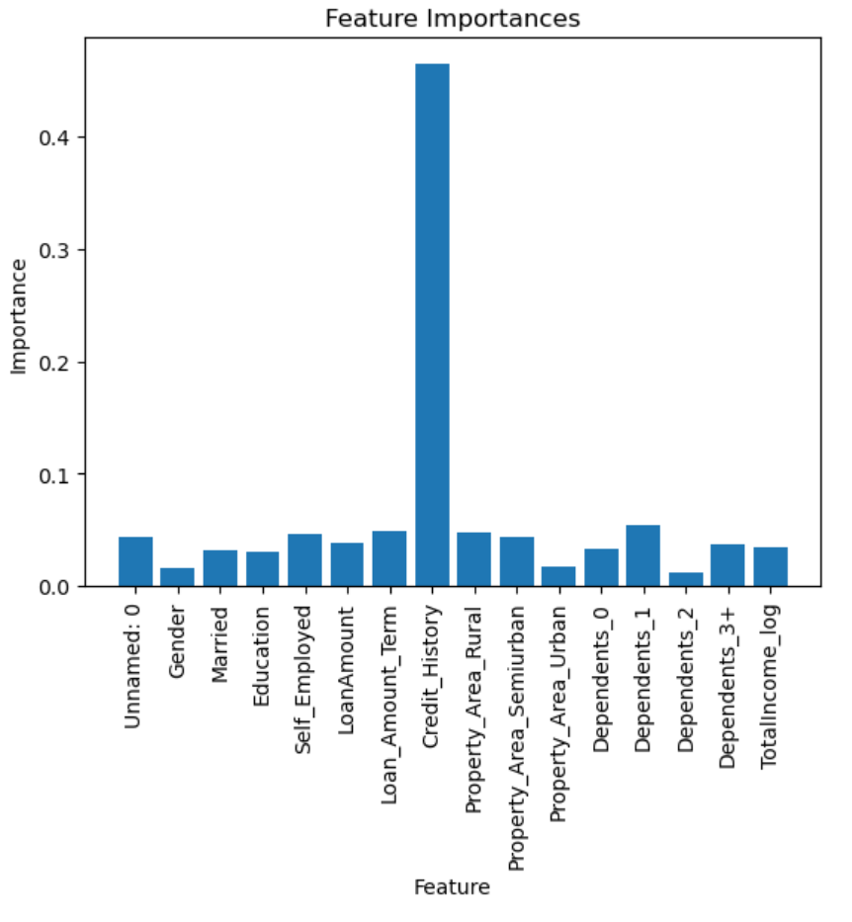
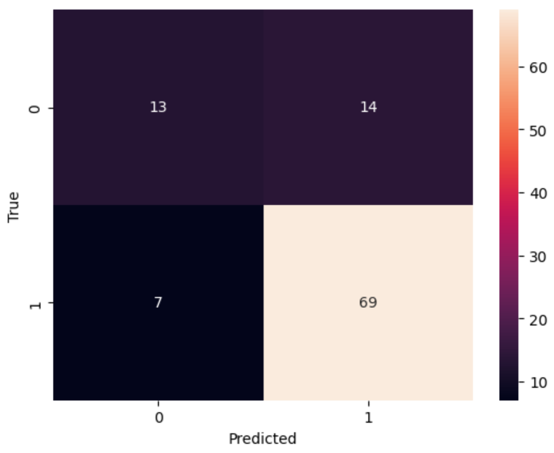

MODELLING – XG BOOST

Slide 8
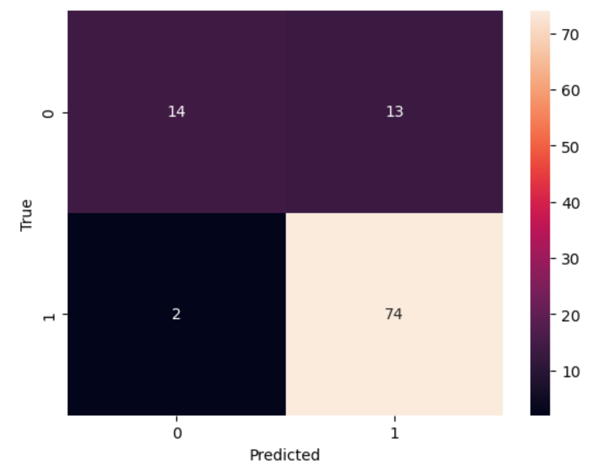
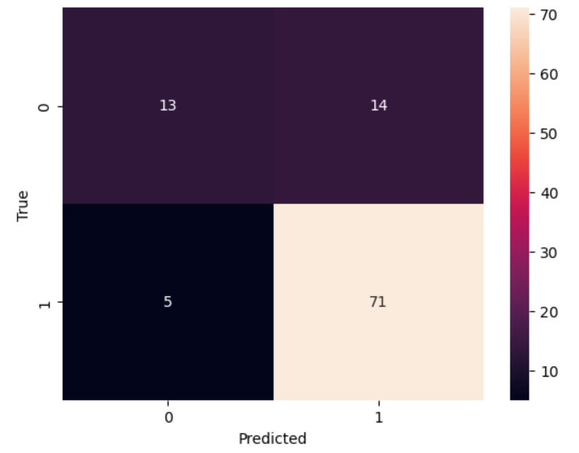
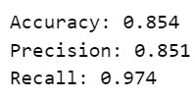

MODELLING
Naïve Bayes
Random Forest

Slide 9
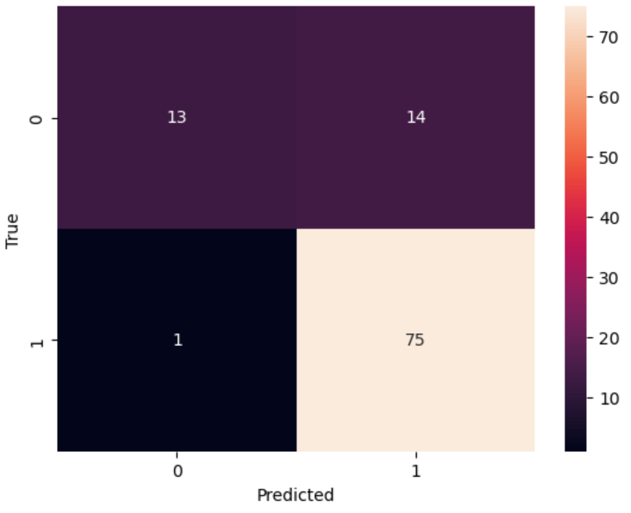

MODELLING
Logistic Regression

Slide 10
Areas for future analysis
Do different encoding types change the outcome?
Why didn’t scaling affect the results? Both Standard and Min-Max
How do the default args affect the results – Grid Search to tune the parameters
Pipelines

